Slide 1

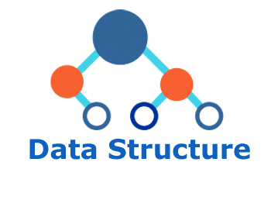
Why Data Structure?
Applications of Data Structures
DIUBLC

Slide 2
Data Structure (1/3)
Data – leads to fact, figure, quantity etc
  e.g. 150, Rahim, Dhaka etc
  Data need storage in the memory
  Data need to be organized in the memory
  Why?
    To store the data efficiently (in short time)
    To process the data cleverly (in lower storage)
Data Structure helps computing to efficiently store data and process cleverly
DSAH@DS, Week-1

Slide 3
Data Structure (2/3)
Data Structure
  Foundation of computer science
  You must develop strong feeling about data structure applications
Data Structure
  Provide efficient arrangement to store data in the memory e.g. Link-List, Stack, Queue, Tree, Graph etc
  Each data structure define how to store and manupulate data
DSAH@DS, Week-1

Slide 4
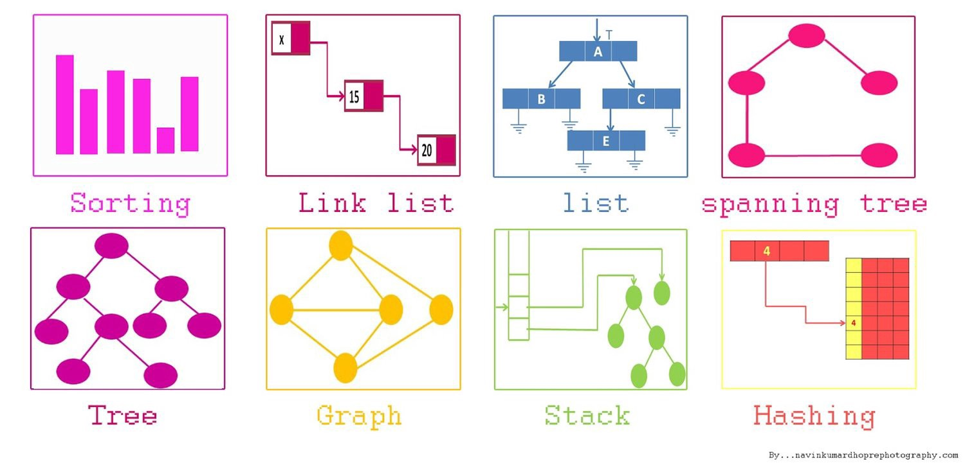
Data Structure (3/3)
Data Structures
Different data strucures are having different applications
DSAH@DS, Week-1

Slide 5
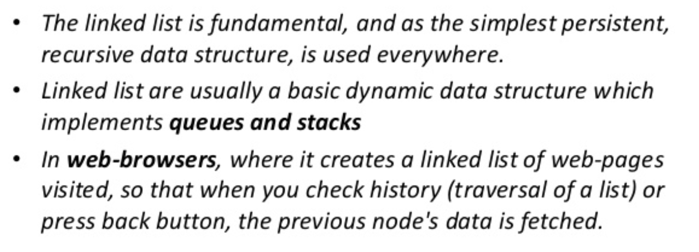
Data Structure Applications
Link-List
DSAH@DS, Week-1

Slide 6
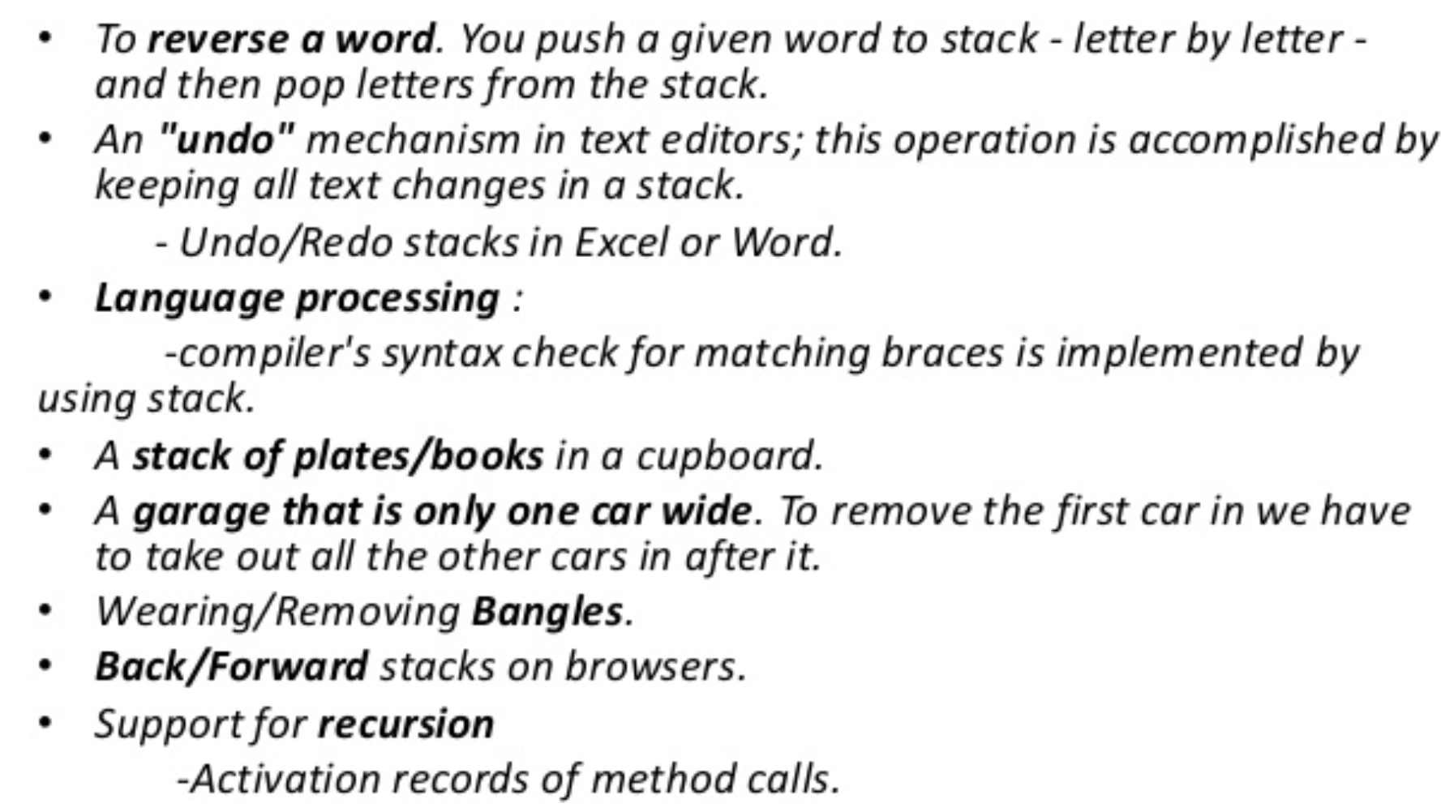
Data Structure Applications
Stack
DSAH@DS, Week-1

Slide 7
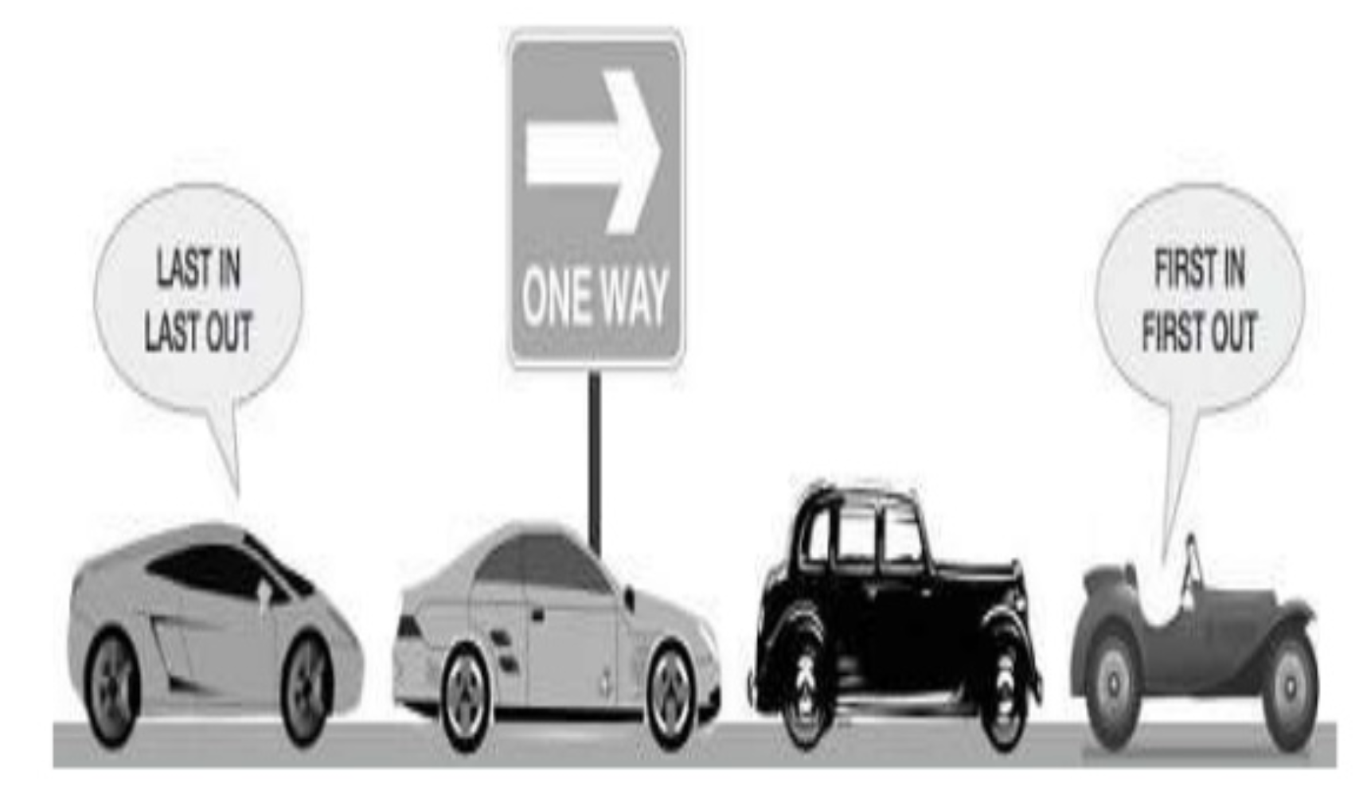
Data Structure Applications
Queue
DSAH@DS, Week-1

Slide 8
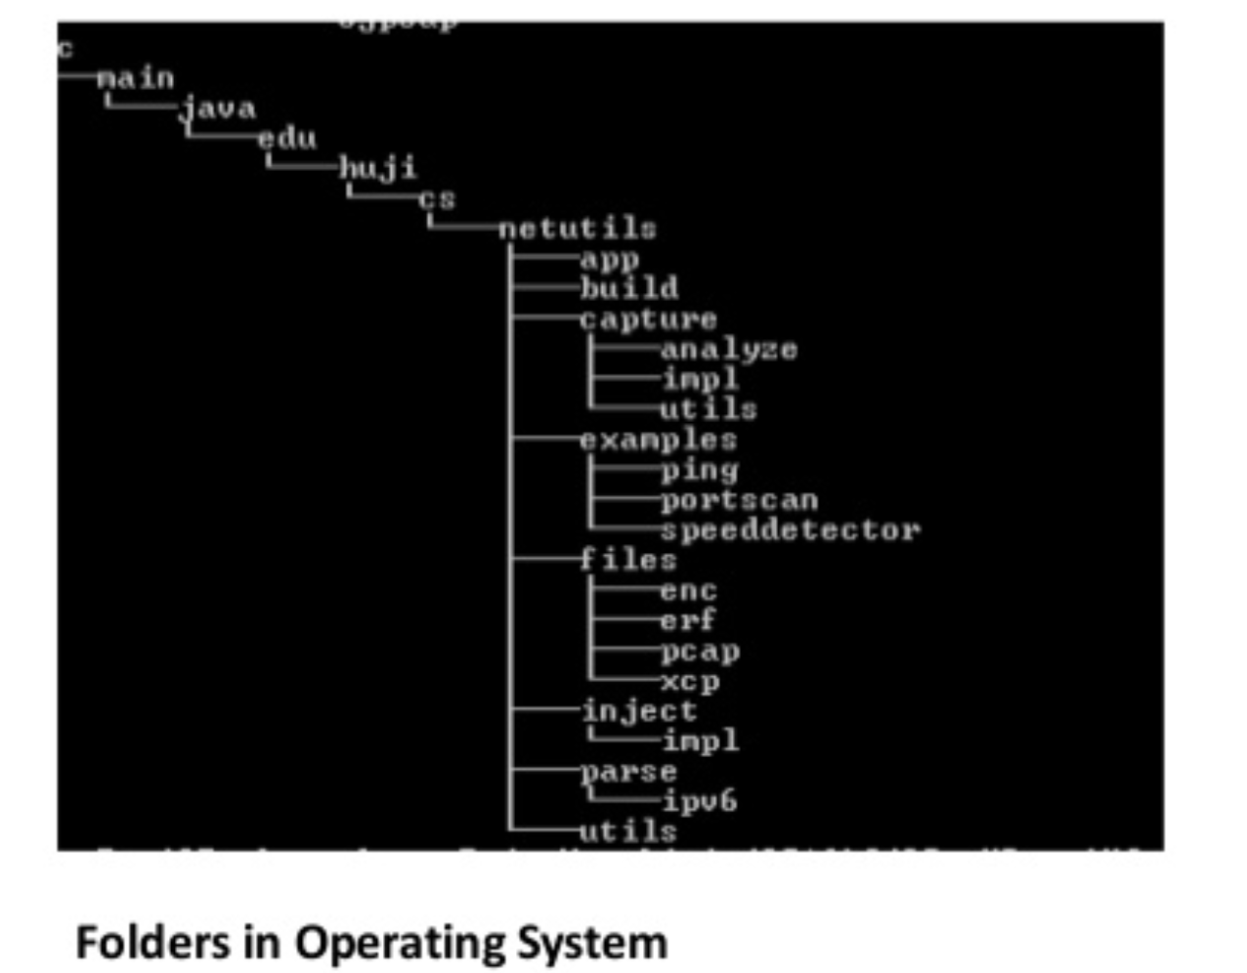
Data Structure Applications
Tree
DSAH@DS, Week-1

Slide 9
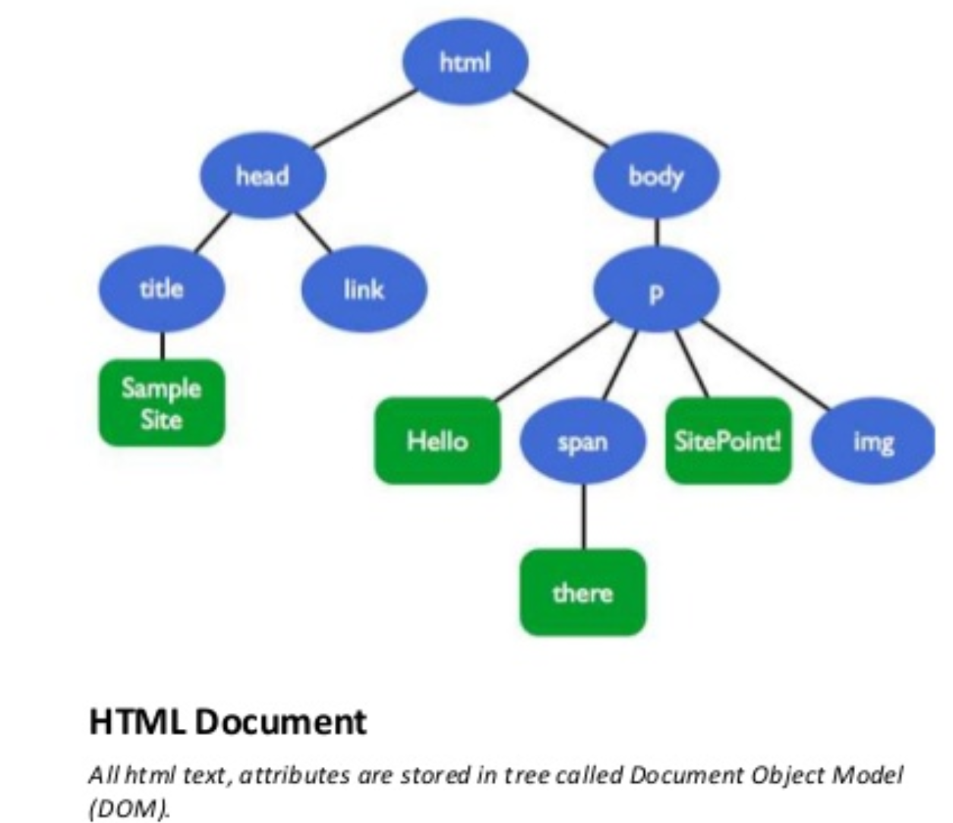
Data Structure Applications
Tree
DSAH@DS, Week-1

Slide 10
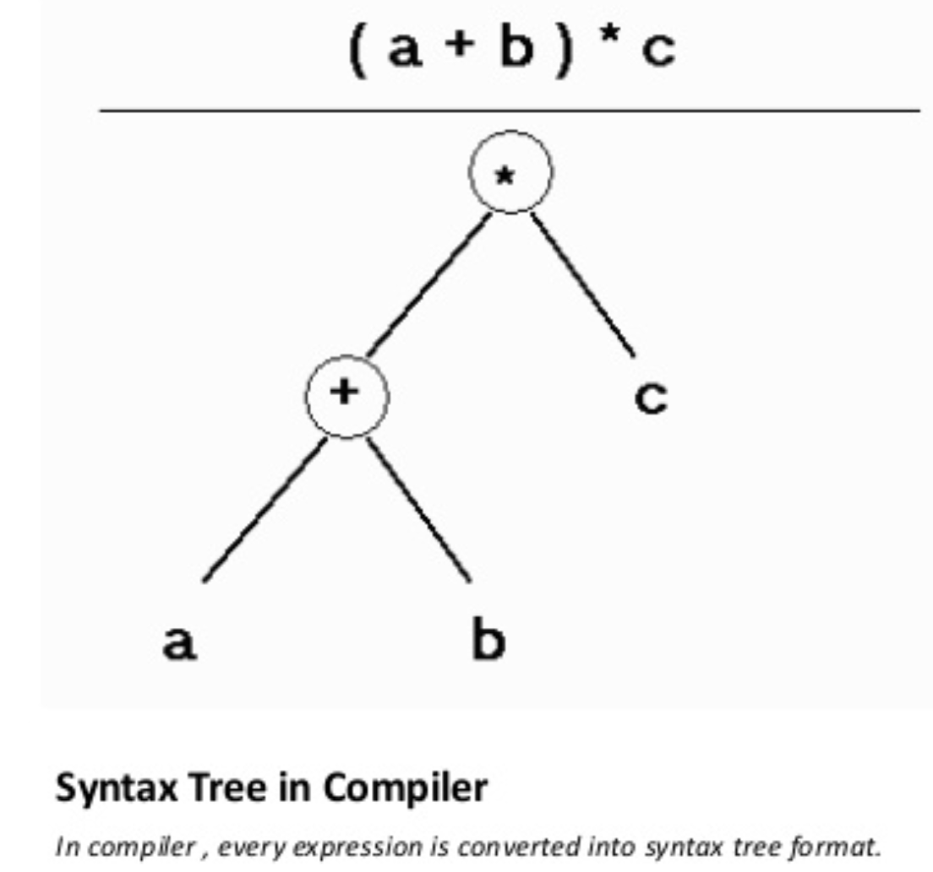
Data Structure Applications
Tree
DSAH@DS, Week-1

Slide 11
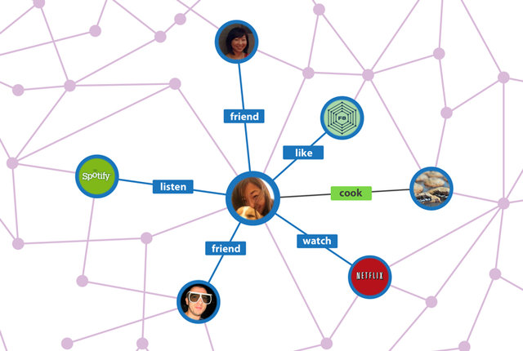
Data Structure Applications
Graph
DSAH@DS, Week-1

Slide 12
Summary
Data Structure is a foundation
Core competency is the key to success
Application of data structure is diversive
Heart of Computer Science
DSAH@DS, Week-1

